Slide 1
John 15:4-7
⁴ Abide in me, and I in you. As the branch cannot bear fruit of itself, except it abide in the vine; no more can ye, except ye abide in me.
⁵ I am the vine, ye are the branches: He that abideth in me, and I in him, the same bringeth forth much fruit: for without me ye can do nothing.
⁶ If a man abide not in me, he is cast forth as a branch, and is withered; and men gather them, and cast them into the fire, and they are burned.
⁷ If ye abide in me, and my words abide in you, ye shall ask what ye will, and it shall be done unto you.

Slide 2

Abiding in Jesus
John 15:4-7
www.RandyColeSimsSr.com

Slide 3
INTRODUCTION
This lesson seeks to encourage those that have a desire to please God, which will help us to be able to spend eternity with God, to abide in Jesus that we can be at rest throughout all of eternity.
The goal is to speak to the need for an ongoing commitment from those that desire to please our creator.
Abide- to stand fast; remain; go on being.

Slide 4
I. What (does it mean to abide)
A. We must be in Christ body
Ephesians 1:22-23, Colossians 1:18
1. Elaborate on how we got into the body
(what we did to become members).
B. We walk in him Colossians 2:6
C. We must be in his family Romans 8:14-17

Slide 5
II. How (do we abide)
A. Be obedient Ecclesiastes 12:13
B. Abound in the work of the Lord
I Corinthians 15:58
C. Live worthy of our calling Ephesians 4:1-3
D. Be doers of the word (work) James 1:22
E. Serve with all our heart Deuteronomy 10:12
F. Serve Fervently Romans 12:11

Slide 6
III. Why (should we abide)
A. There is no condemnation in him
Romans 8:1-4
B. So nothing can separate us
Romans 8:35-39
C. To be confident of our salvation
II Peter 1:8-10
D. To receive an eternal reward
Revelations 2:10

Slide 7
CONCLUSION
As a result of our study of this subject matter, I am hopeful, even prayerful that we have gained greater insight as to what it means, how we can, and why we must be “Abiding in Christ.”

Slide 8
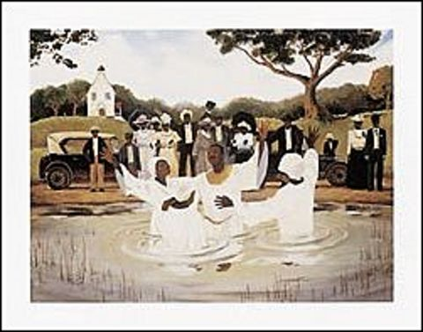
WHAT MUST I DO TO BE SAVED?
Acts 16:30

Slide 9
WHAT MUST I DO TO BE SAVED?
HEAR the Gospel – Romans 10:17
BELEIVE the Gospel / God – Hebrews 11:6
REPENT of sins – Acts 17:30
CONFESS Jesus Christ – Matthew 10:32-33
Be BAPTIZED – Acts 2:38, Galatians 3:26-27
Be FAITHFUL – Revelations 2:10

