Slide 1
Hebrews 12:1-2
1 Therefore, since we are surrounded by so great a cloud of witnesses, let us also lay aside every weight, and sin which clings so closely, and let us run with endurance the race that is set before us, 2 looking to Jesus, the founder and perfecter of our faith, who for the joy that was set before him endured the cross, despising the shame, and is seated at the right hand of the throne of God.

Slide 2
John 15:4-7
Abide in me, and I in you. As the branch cannot bear fruit by itself, unless it abides in the vine, neither can you, unless you abide in me. 5 I am the vine; you are the branches. Whoever abides in me and I in him, he it is that bears much fruit, for apart from me you can do nothing. 6 If anyone does not abide in me he is thrown away like a branch and withers; and the branches are gathered, thrown into the fire, and burned. 7 If you abide in me, and my words abide in you, ask whatever you wish, and it will be done for you.

Slide 3
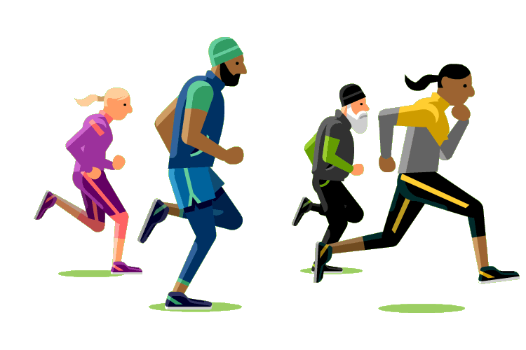
FINISHING THE RACE
Hebrews 12:1-2 & John 15:4-7

Slide 4
Introduction
This lesson seeks to encourage members of the
Body of Christ to complete what we have begun
in faithful, obedient, fashion. Since we don’t
know when the conclusion of our journey might
be realized, it behooves us to strive for
consistent, faithful dedication at all times.
FINISHING WELL must be our goal that we can
hear the Lord say “well done!”

Slide 5
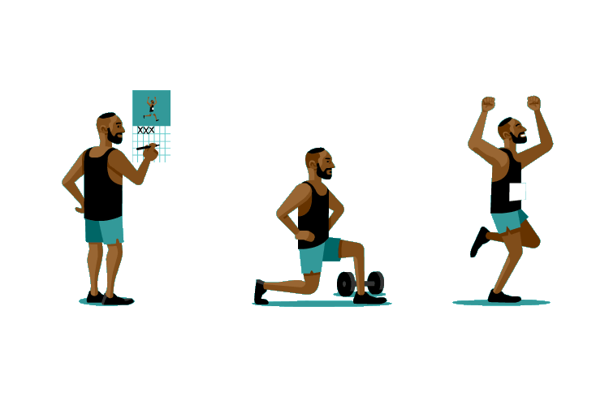
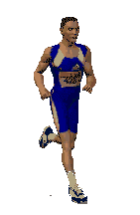
I. Who (do we follow / imitate)
A. Jesus Christ Hebrews 12:1-2
note v. 2
B. We must abide in Jesus Christ
John 15:4-7
1. Abide- to stand fast; remain;
go on being.

Slide 6
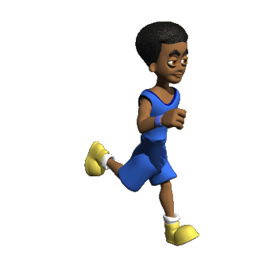
II. What (do we need to do)
A. We must be in Christ body Ephesians 1:22-23,
Colossians 1:18
1. Elaborate on how one gets into the body of
Christ (what did we do to become Christians).
a. Hear Rom. 10:17, Believe Hebrews 11:6,
Repent Acts 17:30, Confess Matt. 10:32-33,
Be Baptized Acts 2:38, Galatians 3:26-27,
Matthew 28:19-20, Mark 16:15-16
B. We walk in him Colossians 2:6
C. We must be in his family Romans 8:14-17

Slide 7
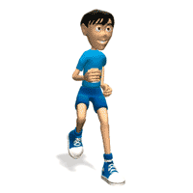
III. How (do we)
A. Be obedient Ecclesiastes 12:13
B. Abound in the work of the Lord
I Corinthians 15:58
C. Live worthy of our calling Ephesians 4:1-3
D. Be doers of the word (work) James 1:22
E. Serve with all our heart Deuteronomy 10:12
F. Serve Fervently Romans 12:11

Slide 8

IV. Why (should we)
A. There is no condemnation in him
Romans 8:1-4
B. So nothing can separate us Romans 8:35-39
C. To be confident of our salvation
II Peter 1:8-10
D. To receive an eternal reward
Revelations 2:10

Slide 9
Conclusion
As a result of our study of this subject matter, I
am hopeful, even prayerful that we have
gained greater insights as to what FINISHING
WELL means.

